Slide 1


Basel Al Shargabi
Date7/22/2024

Slide 2

Outline
Executive Summary
Introduction
Methodology
Results
Conclusion
Appendix

Slide 3
Executive Summary
Introduction
This project aims to develop a machine learning pipeline to predict the success of SpaceX's Falcon 9 rocket landings. By achieving a high success rate, the project seeks to enable Space Y to offer competitive services and reduce launch costs significantly.
Methodology
The data collection involved two primary methods:
API Requests: Data was collected from SpaceX's API.
Web Scraping: Additional data was obtained from Wikipedia using BeautifulSoup.
The data underwent extensive wrangling, including handling missing values and applying one-hot encoding to categorical features. Exploratory Data Analysis (EDA) was performed using visualization techniques and SQL queries to uncover insights. Interactive visual analytics were created using Folium and Plotly Dash. Finally, predictive models were developed using various classification algorithms, and hyperparameters were tuned using GridSearchCV.

Slide 4
Executive Summary
Results:
Key findings from the analysis include:
Launch Site Success Rates: KSC LC-39A had the highest success rate among all launch sites.
Payload and Orbit Analysis: Heavy payloads tend to have higher success rates for specific orbits like PolarLEO and ISS, while GTO orbits showed mixed results.
Yearly Trends: The success rate of launches has steadily increased since 2013, reaching its peak in 2020.
The decision tree classifier emerged as the best-performing model for predicting landing success, with a high accuracy score. However, the model's confusion matrix revealed some issues with false positives, indicating areas for further improvement

Slide 5
Executive Summary
Conclusion
The project successfully developed a predictive model that can help Space Y optimize their launch processes and reduce costs. The insights gained from the EDA and the interactive visualizations provide valuable information for decision-making and strategic planning. The continuous improvement of the model and further analysis of additional features will enhance the accuracy and reliability of the predictions.

Slide 6
Introduction
Project background and context
Space X advertises Falcon 9 rocket launches on its website with a cost of 62 million dollars; other providers cost upward of 165 million dollars each, much of the savings is because Space X can reuse the first stage. Therefore a Space Y company wants to bid against space X for a rocket launch. This goal of the project is to create a machine learning pipeline to predict if the first stage will land successfully that will allow it to minimize the cost of their service to reach the level of Space X
Problems you want to find answers
Build a model to determine if the rocket will land successfully to be used to build the rockets system.
The interaction amongst various features that determine the success rate of a successful landing
What operating conditions needs to be in place to ensure a successful landing program.

Slide 7

Section 1

Slide 8
Methodology
Data collection methodology:
Data was collected using SpaceX API and web scraping from Wikipedia.
Perform data wrangling
One-hot encoding was applied to categorical features
Perform exploratory data analysis (EDA) using visualization and SQL
Perform interactive visual analytics using Folium and Plotly Dash
Perform predictive analysis using classification models
How to build, tune, evaluate classification models

Slide 9
Data Collection
Data collection was done using get request to the SpaceX API.- Next, we decoded the response content as a Json using .json() function call and turn it into a pandas data frame using .json_normalize().
We then cleaned the data, checked for missing values and fill in missing values where necessary. In addition, we performed web scraping from Wikipedia for Falcon 9 launch records with
BeautifulSoup.- The objective was to extract the launch records as HTML table, parse the table and
convert it to a pandas data frame for future analysis.

Slide 10
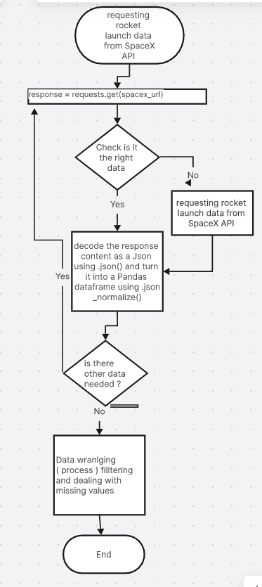
Data Collection – SpaceX API
We used the get request to the SpaceX API to collect data, clean the requested data and did some basic data wrangling and formatting
The link to the notebook is :
https://github.com/BaselMoh/MY-IBM-Data-Scientist-LAbs/blob/main/jupyter-labs-spacex-data-collection-api.ipynb

Slide 11
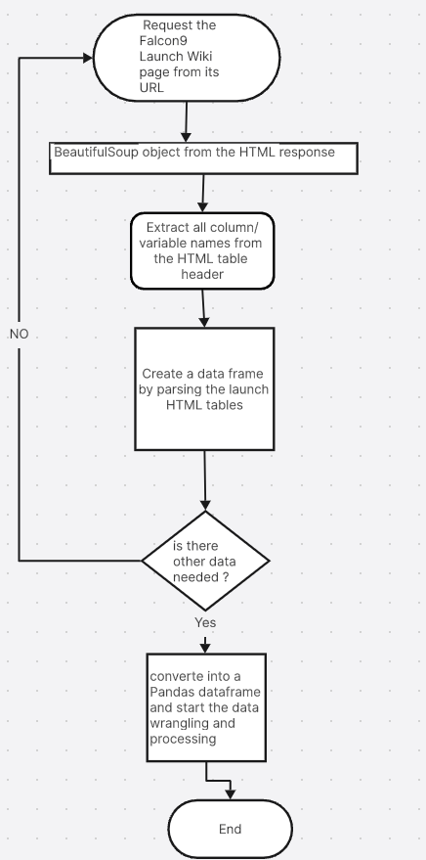
Data Collection - Scraping
We applied web scrapping to web scrap Falcon 9 launch records with BeautifulSoup
We parsed the table and converted it into a pandas data frame.
The link to the notebook is
https://github.com/BaselMoh/MY-IBM-Data-Scientist-LAbs/blob/main/jupyter-labs-webscraping.ipynb
Place your flowchart of web scraping here

Slide 12
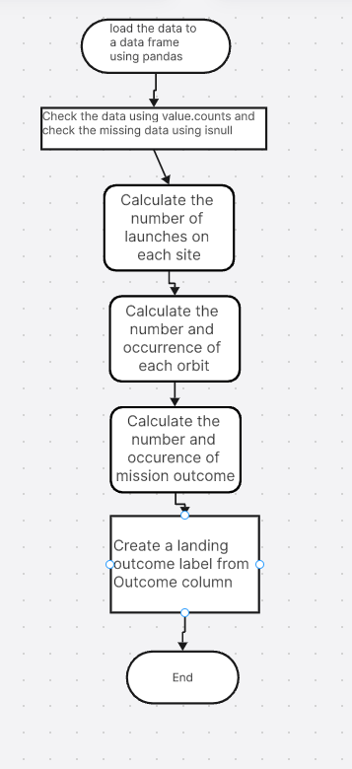
Data Wrangling
We performed exploratory data analysis and determined the training labels.
We calculated the number of launches at each site, and the number and occurrence of each orbits
We created landing outcome label from outcome column and exported the results to csv.
The link to the notebook is
https://github.com/BaselMoh/MY-IBM-Data-Scientist-LAbs/blob/main/labs-jupyter-spacex-Data%20wrangling.ipynb

Slide 13
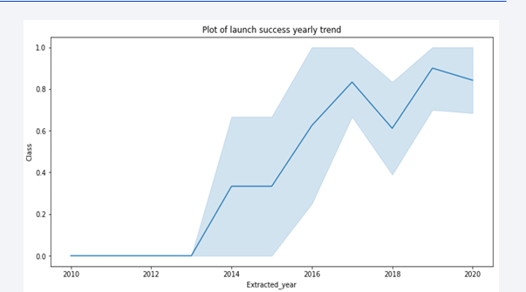
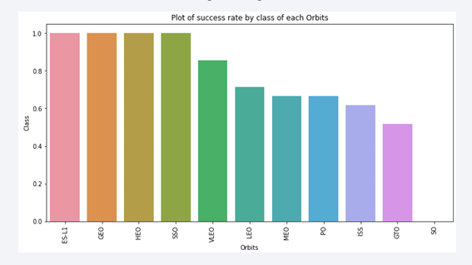
EDA with Data Visualization
We explored the data by visualizing the relationship between flight number and launch Site, payload and launch site, success rate of each orbit type, flight number and orbit type, the launch success yearly trend.
The link to the notebook is https://github.com/BaselMoh/MY-IBM-Data-Scientist-LAbs/blob/main/EDA%20with%20Visualization%20Lab.ipynb

Slide 14
EDA with SQL
We loaded the SpaceX dataset into a PostgreSQL database without leaving the jupyter notebook
We applied EDA with SQL to get insight from the data. We wrote queries to find out for instance:
The names of unique launch sites in the space mission.-
The total payload mass carried by boosters launched by NASA (CRS)-
The average payload mass carried by booster version F9 v1.1
The total number of successful and failure mission outcomes
The failed landing outcomes in drone ship, their booster version and launch site names.
The link to the notebook is :https://github.com/BaselMoh/MY-IBM-Data-Scientist-LAbs/blob/main/jupyter-labs-eda-sql-coursera_sqllite.ipynb

Slide 15
Build an Interactive Map with Folium
We marked all launch sites, and added map objects such as markers, circles, lines to mark the success or failure of launches for each site on the folium map.
We assigned the feature launch outcomes (failure or success) to class 0 and 1.i.e., 0 for failure, and 1 for success.
Using the color-labeled marker clusters, we identified which launch sites have relatively high success rate.
We calculated the distances between a launch site to its proximities. We answered
some question for instance:
Are launch sites near railways, highways and coastlines.
Do launch sites keep certain distance away from cities.
The link for the note : https://github.com/BaselMoh/MY-IBM-Data-Scientist-LAbs/blob/main/lab_jupyter_launch_site_location.ipynb

Slide 16
Build a Dashboard with Plotly Dash
We built an interactive dashboard with Plotly dash
We plotted pie charts showing the total launches by a certain sites
We plotted scatter graph showing the relationship with Outcome and Payload Mass (Kg) for the different booster version.
The link to the notebook is https://github.com/BaselMoh/MY-IBM-Data-Scientist-LAbs/blob/main/spacex_dash_app.py

Slide 17
Predictive Analysis (Classification)
We loaded the data using numpy and pandas, transformed the data, split our data into training and testing.
We built different machine learning models and tune different hyperparameters using GridSearchCV.
We used accuracy as the metric for our model, improved the model using feature engineering and algorithm tuning.
We found the best performing classification model.
The link to the notebook is https://github.com/chuksoo/IBM-Data-ScienceCapstone-SpaceX/blob/main/Machine%20Learning%20Prediction.ipynb

Slide 18
Results
Exploratory data analysis results
Interactive analytics demo in screenshots
Predictive analysis results

Slide 19

Section 2

Slide 20
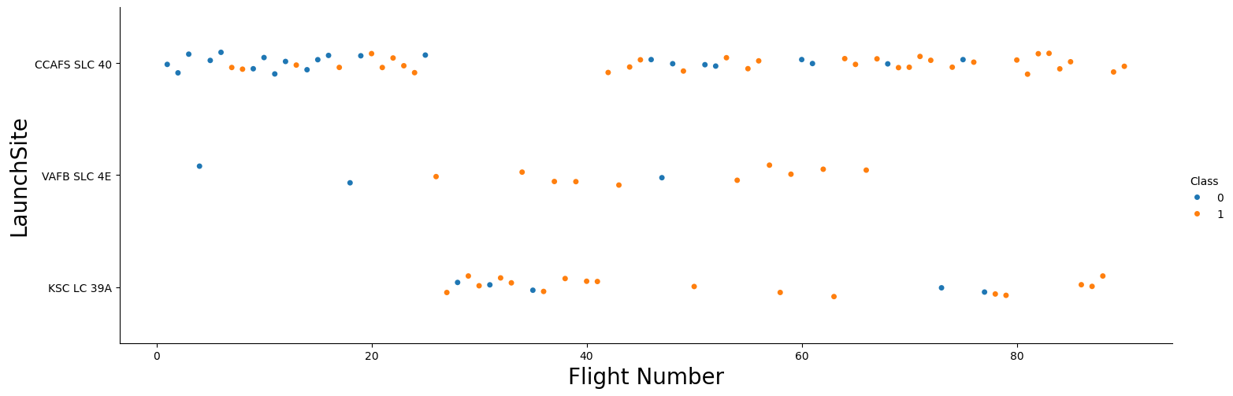
Flight Number vs. Launch Site
From the plot, we found that the larger the flight amount at a launch site, the greater the success rate at a launch site.

Slide 21
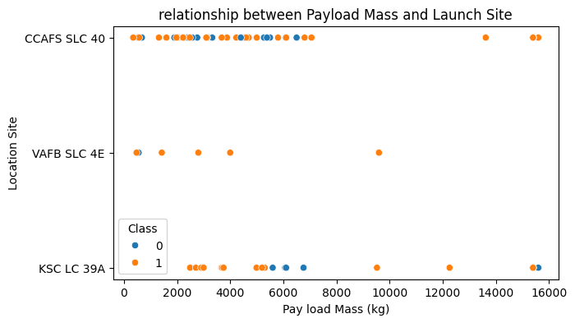
Payload vs. Launch Site
We can observe Payload Mass Vs. Launch Site scatter point chart you will find for the VAFB-SLC launch site there are no rockets launched for heavy payload mass(greater than 10000)

Slide 22
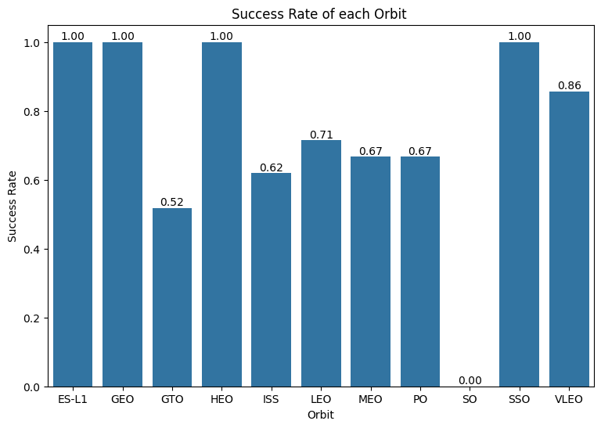
Success Rate vs. Orbit Type
From the plot, we can see that ES-L1, GEO, HEO, SSO, VLEO had the most success rate with the SO location having zero success rate .

Slide 23
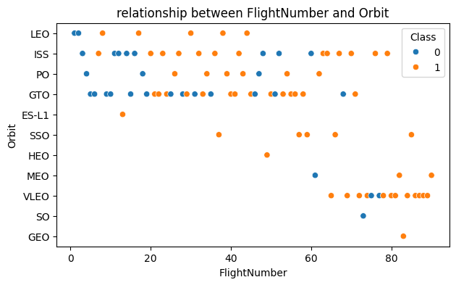
Flight Number vs. Orbit Type
The plot below shows the Flight Number vs. Orbit type. We observe that in the LEO orbit, success is related to the number of flights whereas in the GTO orbit, there is no relationship between flight number and the orbit.

Slide 24
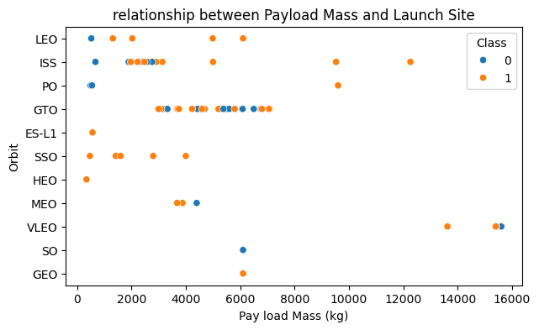
Payload vs. Orbit Type
We can observe that With heavy payloads the successful landing or positive landing rate are more for Polar,LEO and ISS.However, for GTO, it's difficult to distinguish between successful and unsuccessful landings as both outcomes are present

Slide 25
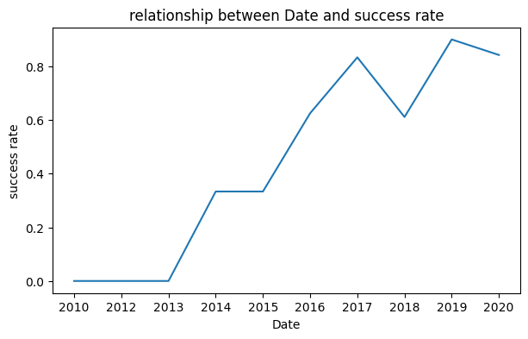
Launch Success Yearly Trend
From the plot, we can observe that success rate since 2013 kept on increasing till 2020

Slide 26
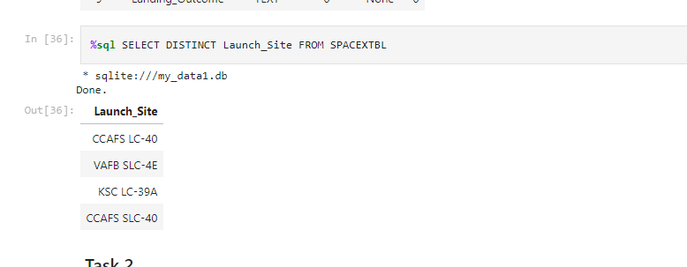
All Launch Site Names
We used the key word DISTINCT to show only unique launch sites from the SpaceX data.

Slide 27
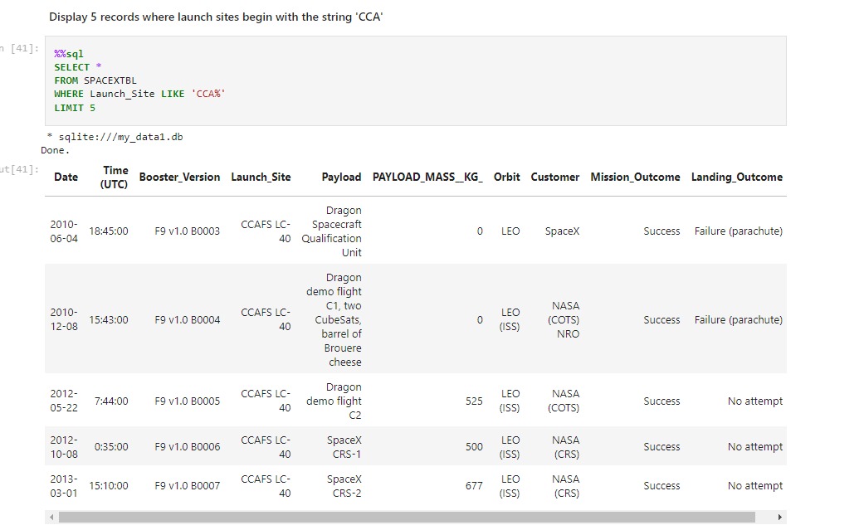
Launch Site Names Begin with 'CCA'
We used the query below to display 5 records where launch sites begin with `CCA`

Slide 28
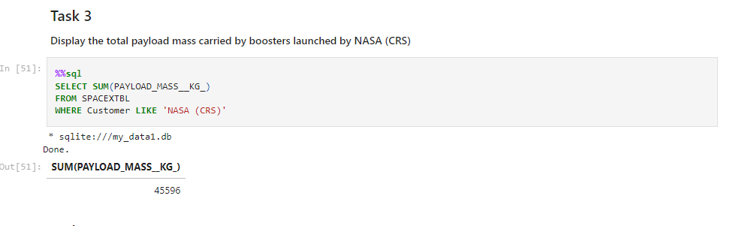
Total Payload Mass
We calculated the total payload carried by boosters from NASA as 45596 using the query below

Slide 29
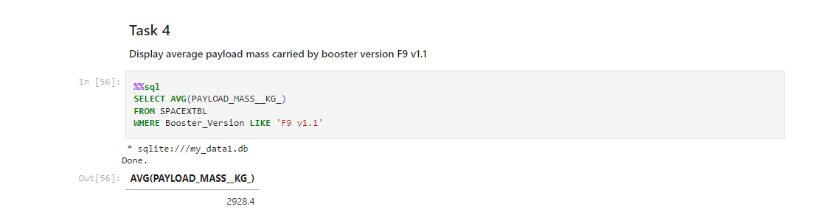
Average Payload Mass by F9 v1.1
We calculated the average payload mass carried by booster version F9 v1.1 as 2928.4

Slide 30
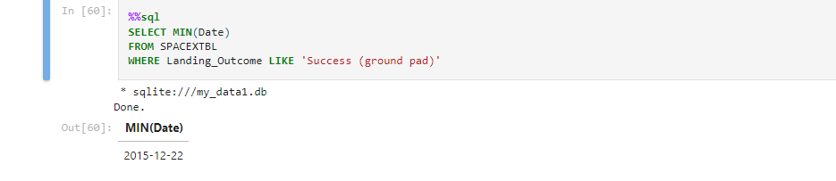
First Successful Ground Landing Date
We observed that the dates of the first successful landing outcome on ground pad was 22nd December 2015

Slide 31
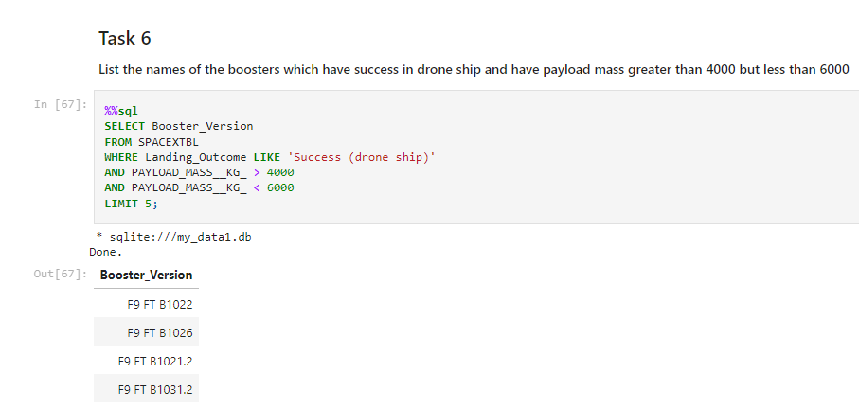
Successful Drone Ship Landing with Payload between 4000 and 6000
We used the WHERE clause to filter for boosters which have successfully landed on drone ship and applied the AND condition to determine successful landing with payload mass greater than 4000 but less than 6000

Slide 32
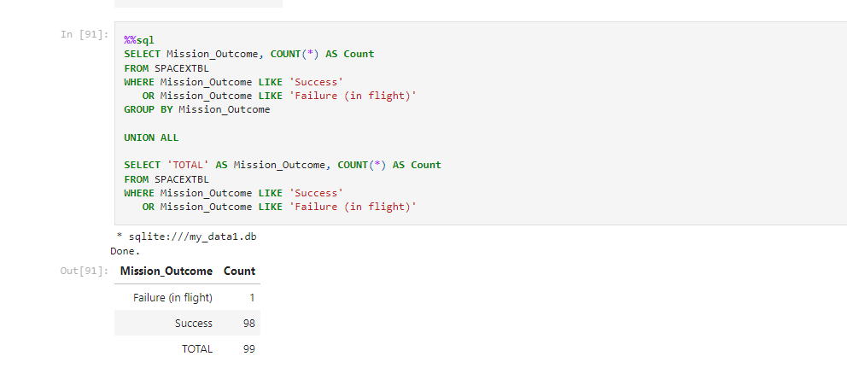
Total Number of Successful and Failure Mission Outcomes
We used wildcard like ‘%’ to filter for WHERE MissionOutcome was a success or a failure.

Slide 33
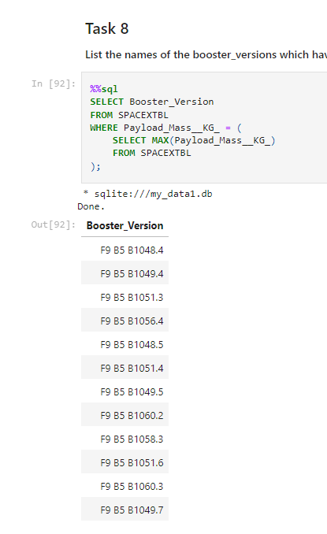
Boosters Carried Maximum Payload
We determined the booster that have carried the maximum payload using a subquery in the WHERE clause and the MAX() function

Slide 34
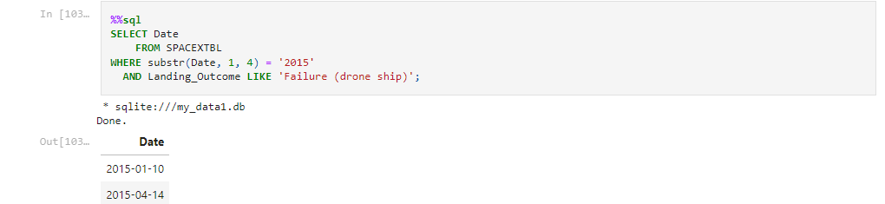
2015 Launch Records
We used a combinations of the WHERE clause, LIKE, AND, and BETWEEN conditions to filter for failed landing outcomes in drone ship, their booster versions, and launch site names for year 2015

Slide 35
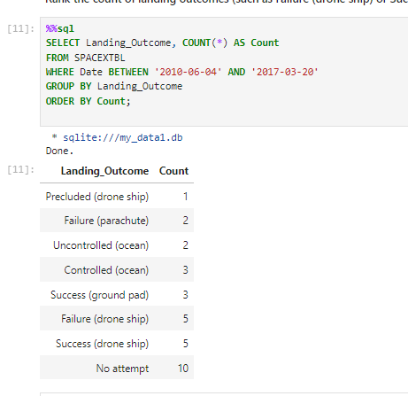
Rank Landing Outcomes Between 2010-06-04 and 2017-03-20
• We selected Landing outcomes and the COUNT of landing outcomes from the data and used the WHERE clause to filter for landing outcomes BETWEEN 2010-06-04 to 2010-03-20. • We applied the GROUP BY clause to group the landing outcomes and the ORDER BY clause to order the grouped landing outcome in descending order.

Slide 36

Section 3

Slide 37
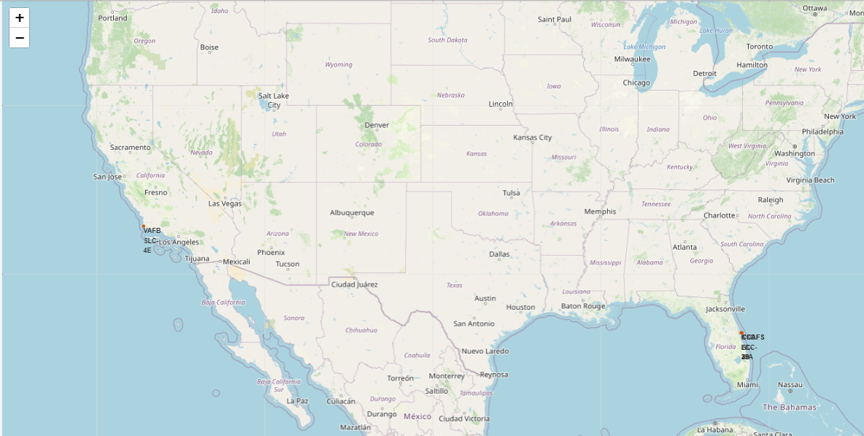
All launch sites global map markers
We can note that all Space lunch locations are in the US coasts areas ( Florida and California)

Slide 38
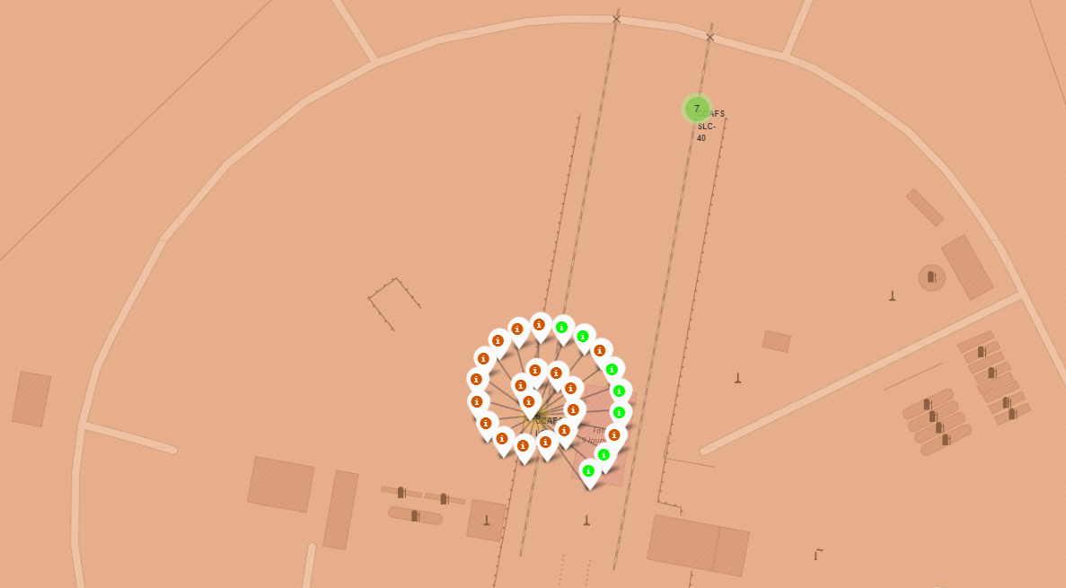
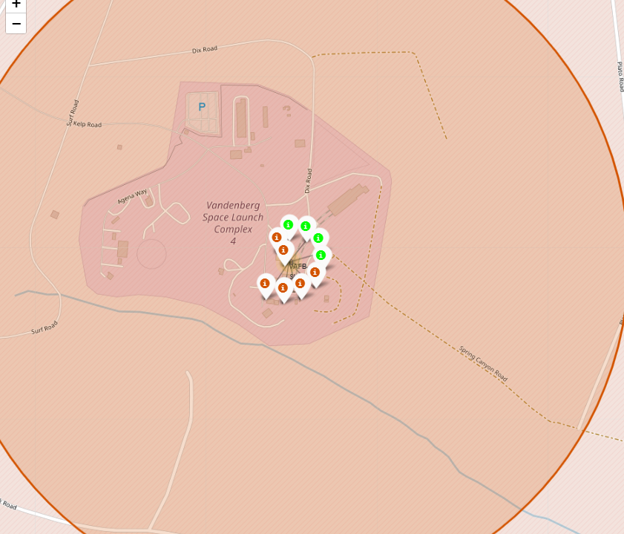
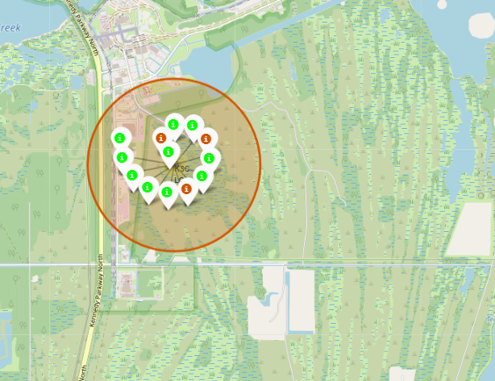
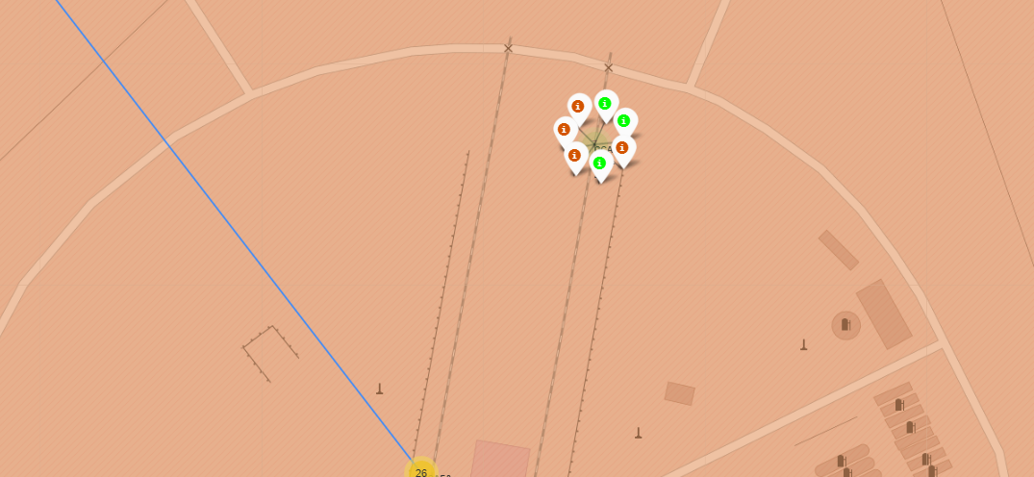
Markers showing launch sites with color labels
We used markers to highlight the success and faultier attempts of landing each site ( green successful and red is a faultier )

Slide 39
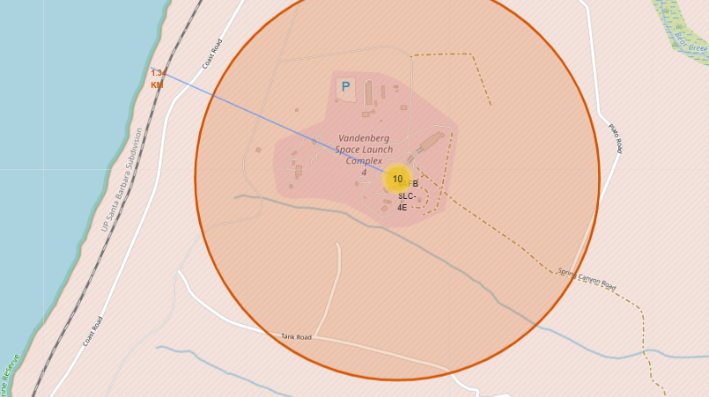
Launch Site Distance to landmarks
Here we highlighted the distance between this site (SLC 4E) and the cost line and it’s 1.3 KM

Slide 40
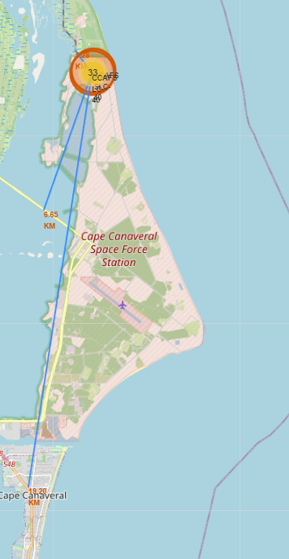
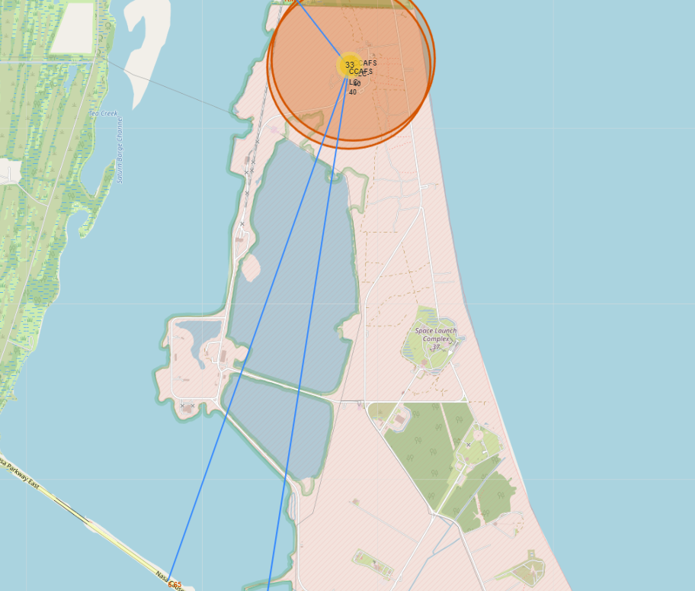
Launch Site Distance to landmarks
Here we highlighted the distance between the other two sites and the landmarks (closes city , closes highway and railway) using the Mouse Position to get the coordination in the map and add_to(marker_cluster) function to add multiple markers to a map
Here is the link for the notebook :
https://github.com/BaselMoh/MY-IBM-Data-Scientist-LAbs/blob/main/lab_jupyter_launch_site_location.ipynb

Slide 41

Section 4

Slide 42
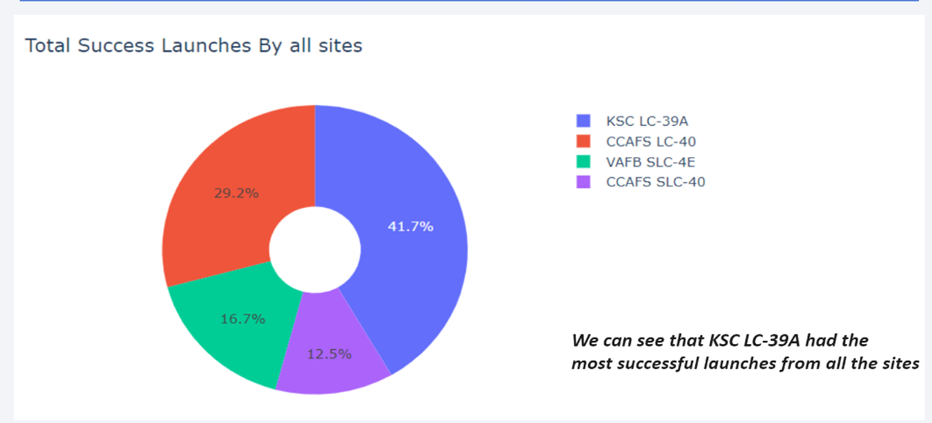
Pie chart showing the success percentage achieved by each launch site

Slide 43
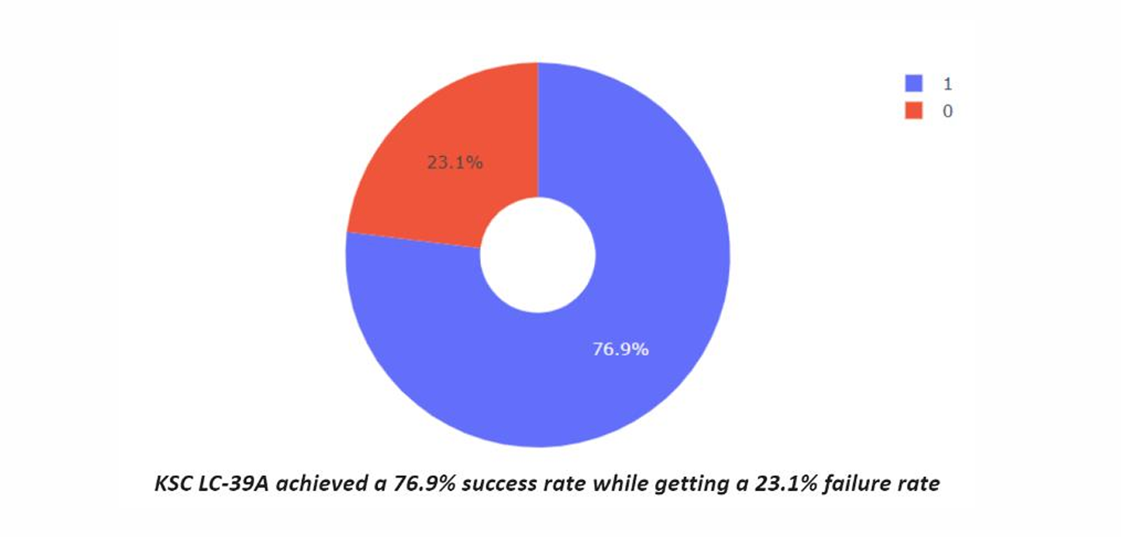
Pie chart showing the Launch site with the highest launch success ratio

Slide 44
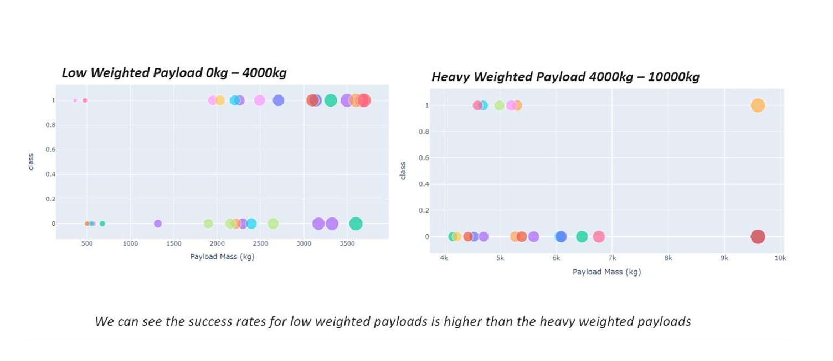
Scatter plot of Payload vs Launch Outcome for all sites, with different
payload selected in the range slider

Slide 45

Section 5

Slide 46
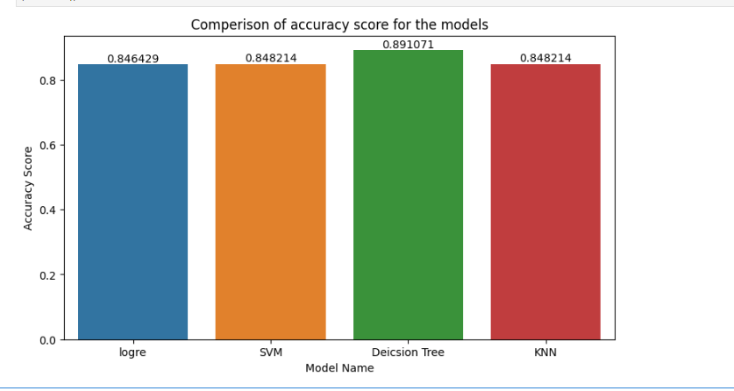
Classification Accuracy
Used the Hyper parameter function GridSearchCV to find the best parameters and then find the best score for each model and then compared each model score using bar plot as showing the graph
The decision tree classifier is the model with the highest classification accuracy
The link for the notebook is :https://github.com/BaselMoh/MY-IBM-Data-Scientist-LAbs/blob/main/SpaceX_Machine%20Learning%20Prediction_Part_5.ipynb

Slide 47
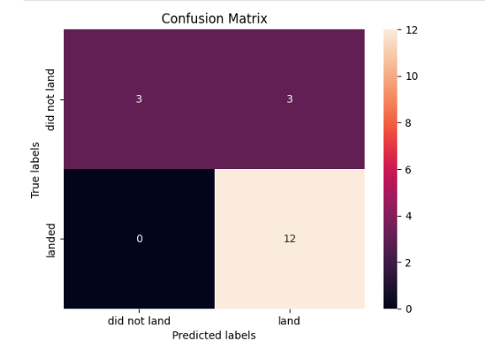
Confusion Matrix
The confusion matrix for the decision tree classifier shows that the classifier can distinguish between the different classes. The major problem is the false positives .i.e., unsuccessful landing marked as successful landing by the classifier.
Here we can see that 3 cases the model has put them as land and in reality they are did not land and this is the model Error

Slide 48
Conclusions
The project successfully developed a predictive model that can help Space Y optimize their launch processes and reduce costs. The insights gained from the EDA and the interactive visualizations provide valuable information for decision-making and strategic planning. The continuous improvement of the model and further analysis of additional features will enhance the accuracy and reliability of the predictions and here is the main points :
The larger the flight amount at a launch site, the greater the success rate at launch site.
Launch success rate started to increase in 2013 till 2020.
Orbits ES-L1, GEO, HEO, SSO, VLEO had the most success rate.
KSC LC-39A had the most successful launches of any sites.
The Decision tree classifier is the best machine learning algorithm for this task.

Slide 49


